Slide 1




CIS4560-01 Term Project
Group 4: Michael Bates, Jorge Pivaral, Kevin Orozco, Eleazar Maldonado, Victor Zuniga

Slide 2
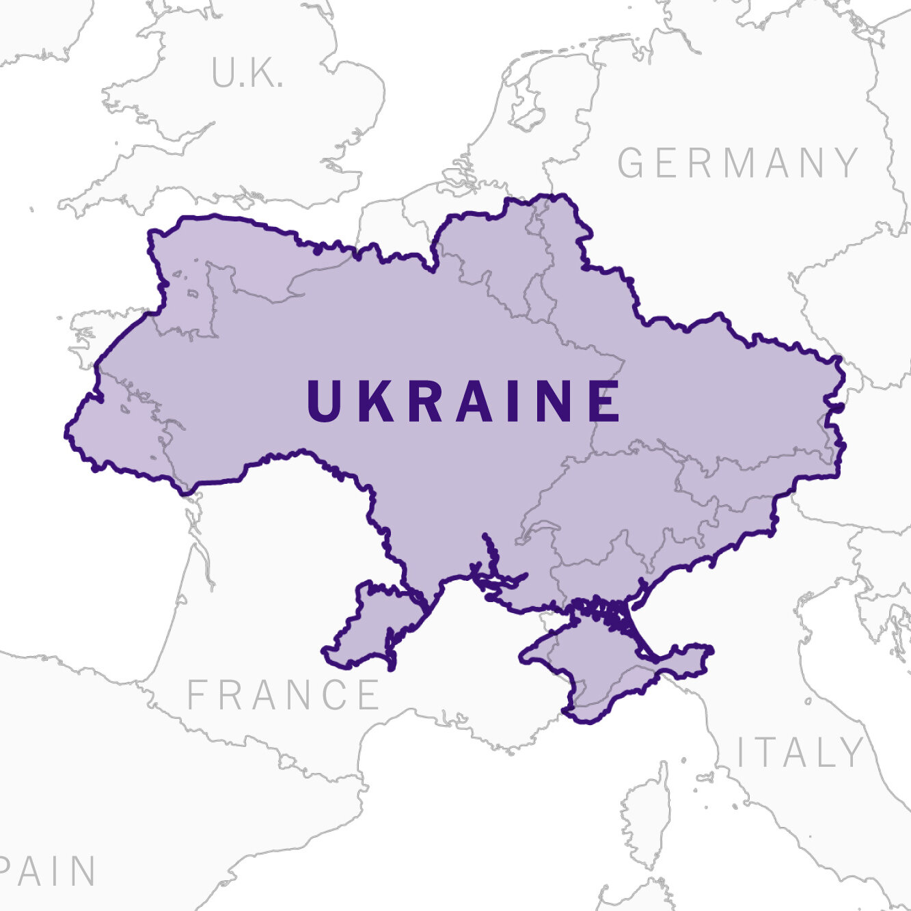
Context For The Data
Russia invaded Ukraine on February 24, 2022
Tensions began in 2014 following the Ukrainian Revolution of Dignity (Maidan Revolution)
Conflict has gotten worse for the past 3 months

Slide 3

Dataset: Ukraine Conflict Tweets
Dataset consists of tweets relating to the ongoing Russia-Ukraine conflict
Conflict has sparked outrage and very outspoken responses from all over the world
General public opinion can be inferred from live Tweets during the events

Slide 4

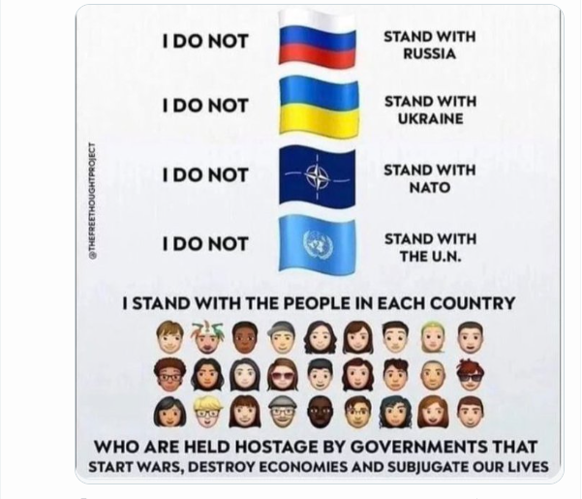

Ukraine Tweets
z

Slide 5
Data Specifications
Original Dataset URL: https://www.kaggle.com/datasets/bwandowando/ukraine-russian-crisis-twitter-dataset-1-2-m-rows
Approximately 7GB compressed
Approximately 17GB Uncompressed
Data is in a .CSV file format
Dataset contains Twitter data related to the Russian-Ukrainian war from the end of February until today.

Slide 6
Data Specification Cont.
18 Columns
1,048,576+ Rows/Lines
Data headers: daily count, userid, username, acctdesc, location, following, followers, totaltweets, usercreatedts, tweetid, tweetcreatedts, retweetcount, text, hashtags, language, coordinates, favorite_count, extracted timestamps
Data types include numerical, text, timestamp, NULL, and JSON formatted data

Slide 7
Server Specifications
Using the class Hadoop cluster and Linux server from Sunday Morning May 8th, 2022
Hadoop Version 3.2.1 and Hive/Beeline Version 3.1.2
At least 2 nodes within the cluster
Linux server CPU: Xeon E5-2670 v2 @ 2.50GHz 10 Cores/20 Threads although server reports as a 4 Core/8 Thread CPU
RAM: Linux server has 32 gigabytes of memory
Linux Storage is 90GB for / and Hadoop has approximately 144GB configured for use

Slide 8
What Are We Doing With the Data?
Sample the data since the original dataset is too large
Chose to use data from the month of march and the last two days of February which was 13.2GB uncompressed
Clean the data using Tableau Prep Builder
Upload to Hadoop and import into Hive
Conduct basic data analysis using SQL queries, sentiment analysis, and Tableau

Slide 9
Data Cleaning
Removed 3 columns from the dataset: daily counter, hashtags, and coordinates
The counter reset daily, which doesn't provide any meaningful data overall
The hashtag column was in JSON format but didn't appear to contain any useful data and ultimately wasn't needed for the intended analysis
Coordinate column was empty (full of Null values)
Removed punctuation and extra spaces from all text columns

Slide 10
Data Preparation
The result of cleaning shrunk the dataset to approximately 6.6GB and a properly formatted .CSV file
Sampled, cleaned, and transformed dataset was uploaded to one drive in preparation for analysis
Created the first table in beeline containing all the cleaned data columns, following tables derived data from that first table
Github Link: https://github.com/micheat/CIS4560-Big-Data-Project/tree/main

Slide 11
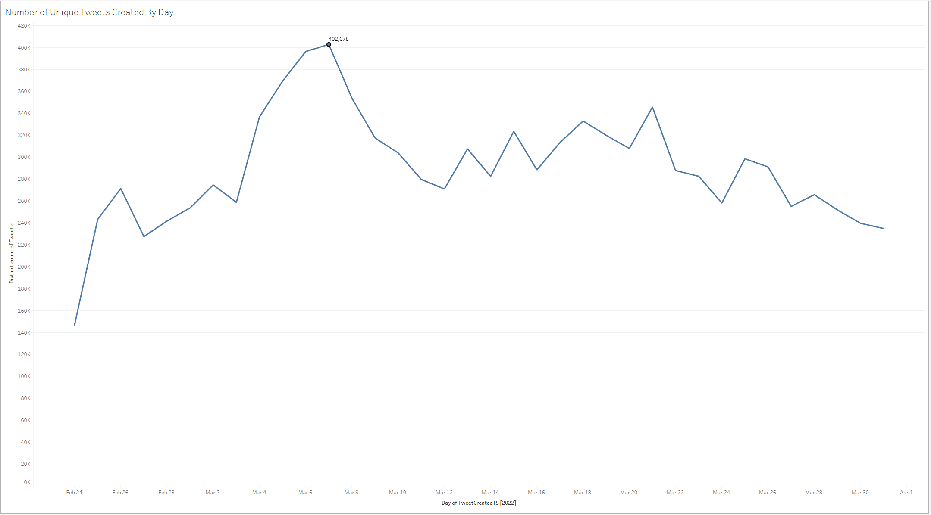
Number of Unique Tweets By Day

Slide 12
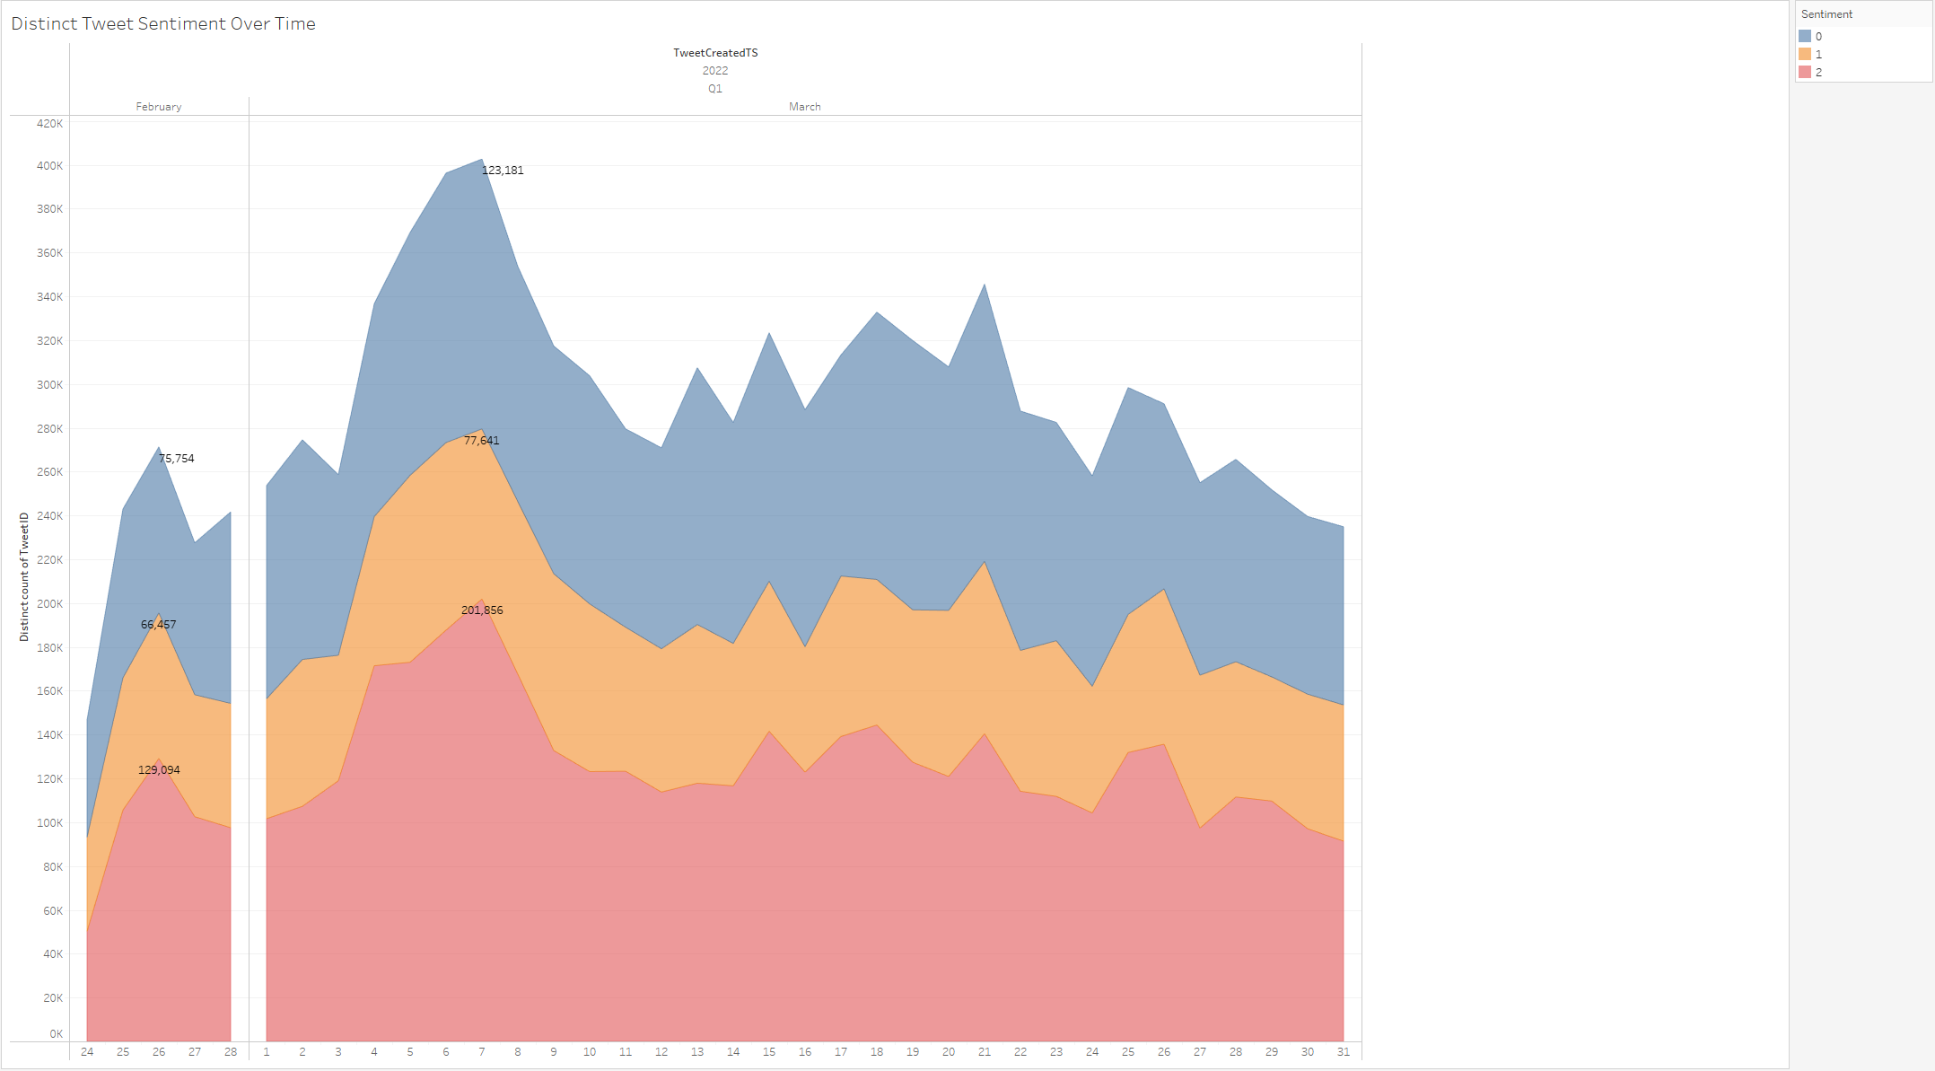
Distinct Tweet Sentiment Over Time

Slide 13
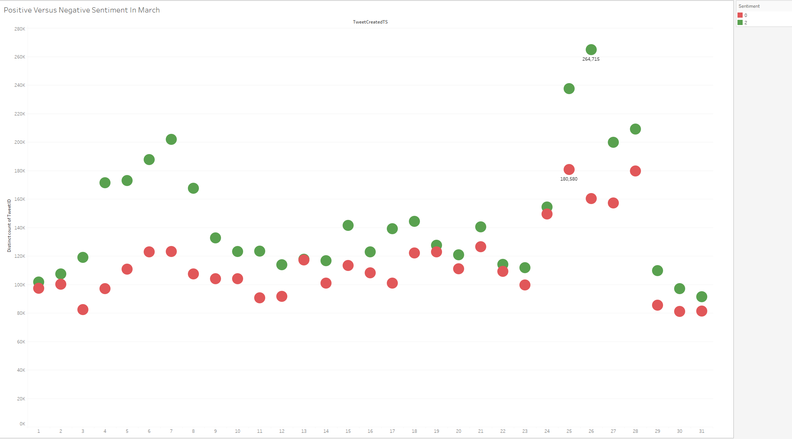
Positive Versus Negative Sentiment in March

Slide 14
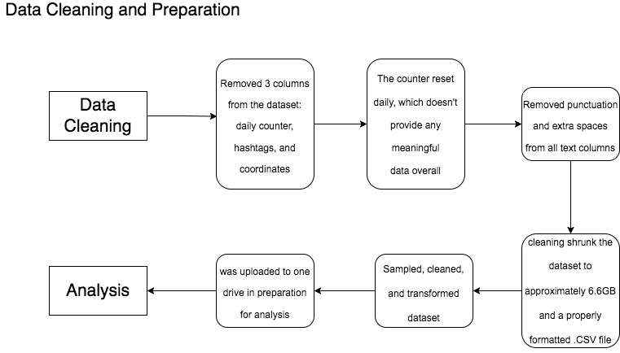
Data Cleaning Process Chart

Slide 15
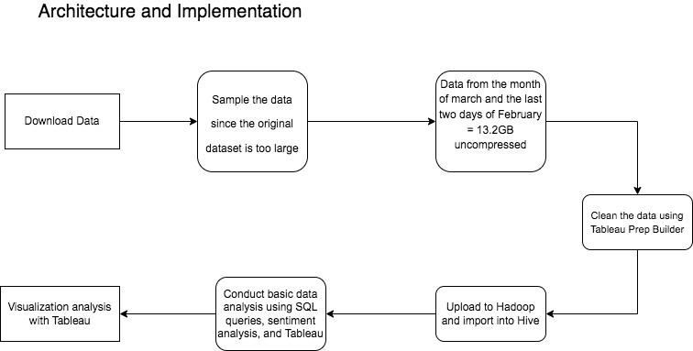
Architecture & Implementation Chart

Slide 16
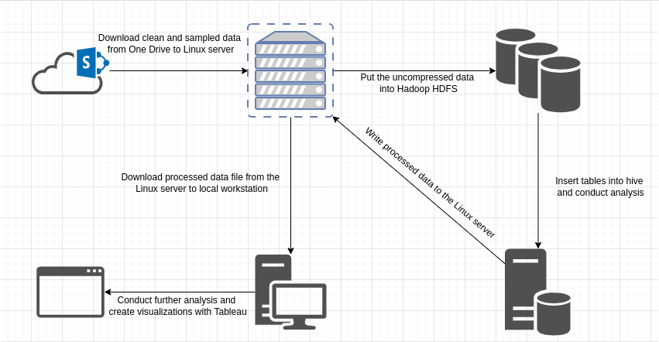
Tutorial Workflow

Slide 17
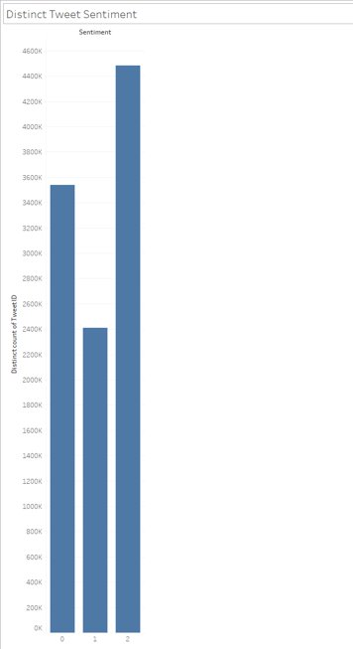
What Information Can Be Derived From This?
We can determine the sentiment regarding how people in English-speaking countries feel about the ongoing conflict through their tweets.
Data shows people's opinions/emotion based on their Tweets
Find which days within the first month and a quarter people were most active when tweeting about the conflict

Slide 18
Thank You For Listening To Our Presentation.
Questions?

